Slide 1
Bachelor & Master Theses Information Session
01. October 2025
Chair of HRM and Leadership
Department of Business Administration
https://www.business.uzh.ch/en/research/professorships/hrmlead.html

Slide 2
Agenda
Presentation of the Chair of Human Resource Management and Leadership
The scientific process
Organization of the BA-/MA-Thesis
Presentation of supervised research ideas
Questions

Slide 3
Presentation of the Chair of Human Resource Management and Leadership

Slide 4
Presentation of the Chair
The Chair of Human Resource Management and Leadership is part of the Department of Business Administration within the Faculty of Business, Economics and Information Technology.
Important questions driving our work:
What is the difference between effective and ineffective leadership?
What factors lead to charisma?
What motivates people to expend effort at work?
How can people work together in ways that facilitate task accomplishment and high performance?
What is the skill set employees need in the 21st century?

Slide 5
Presentation of the Chair
In our research,
We focus on the social dynamics between leaders and followers and on the role of emotions, motivation, and digitalization in organizational life.
We employ primarily quantitative methods and conduct carefully controlled experiments as well as field and archival studies in organizations.

Slide 6
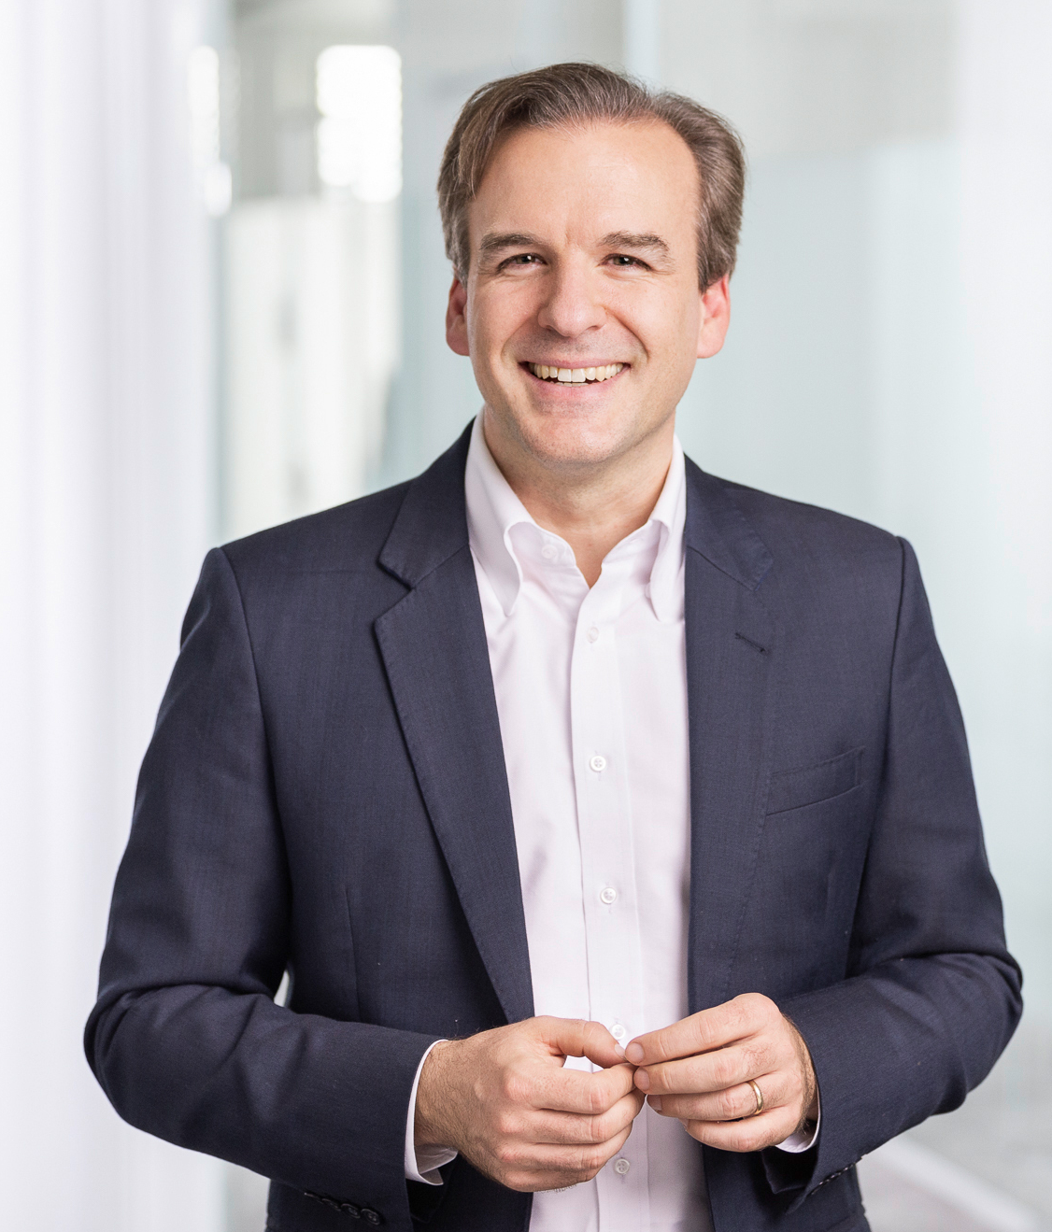
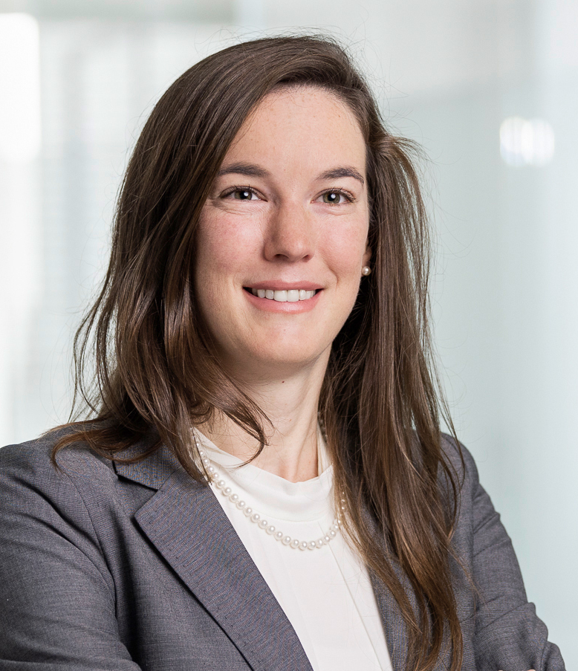
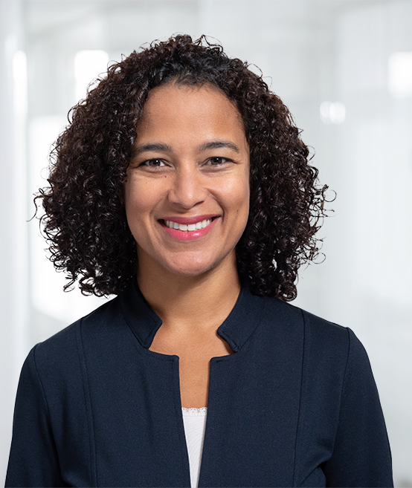
Presentation of the Chair
Prof. Jochen Menges
Prof. Lauren Howe
Lissette Cabrera

Slide 7
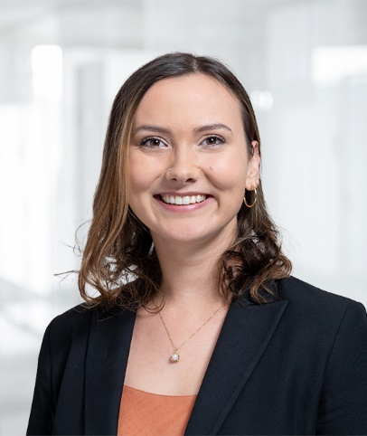

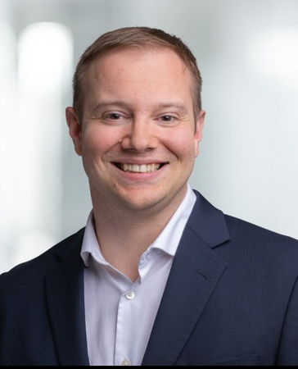
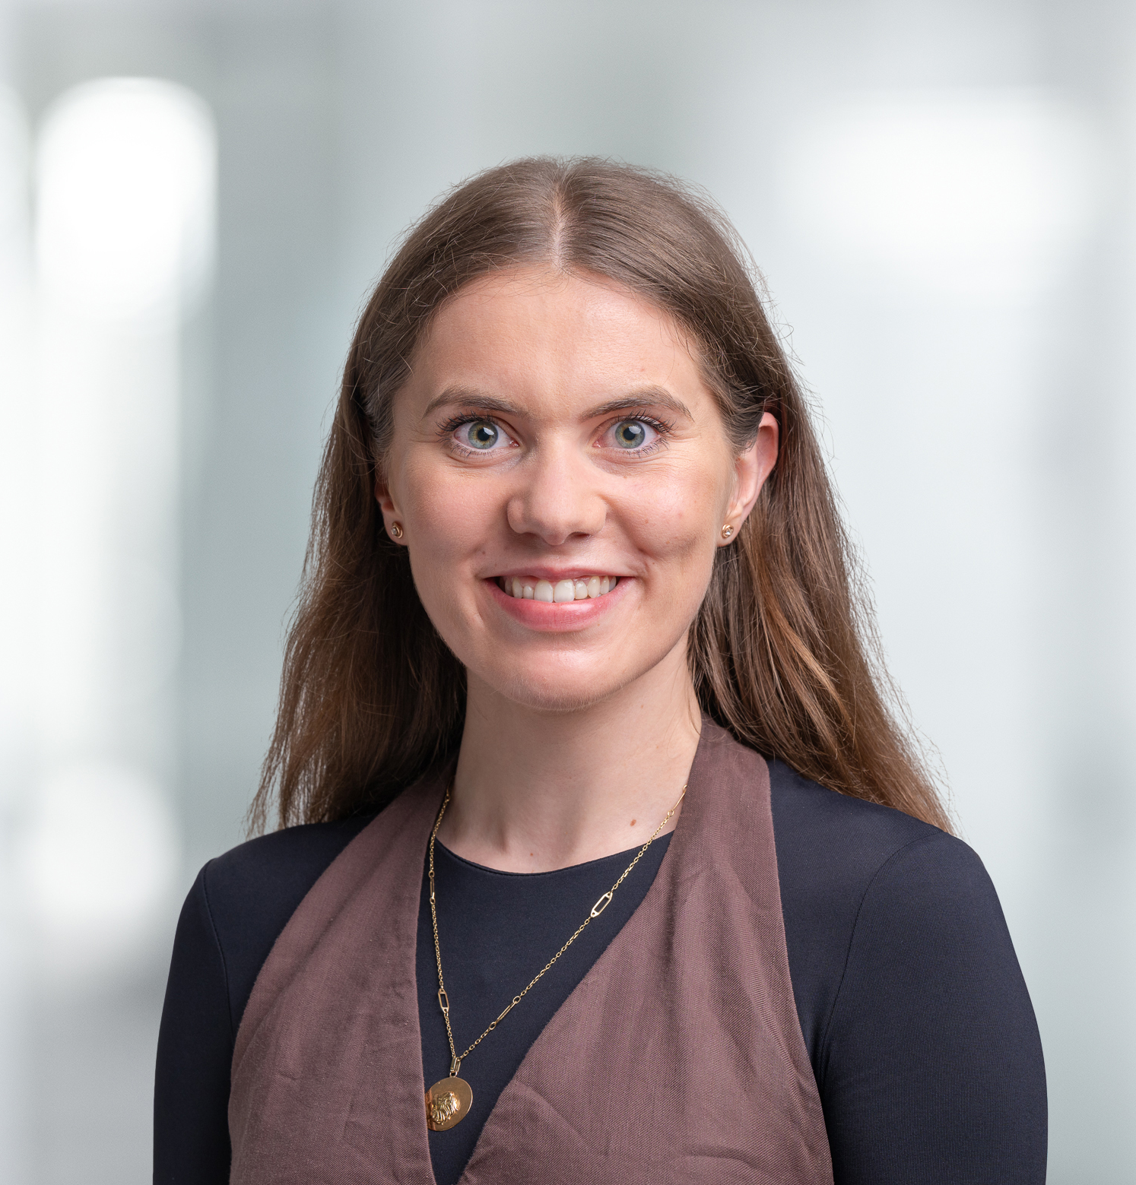
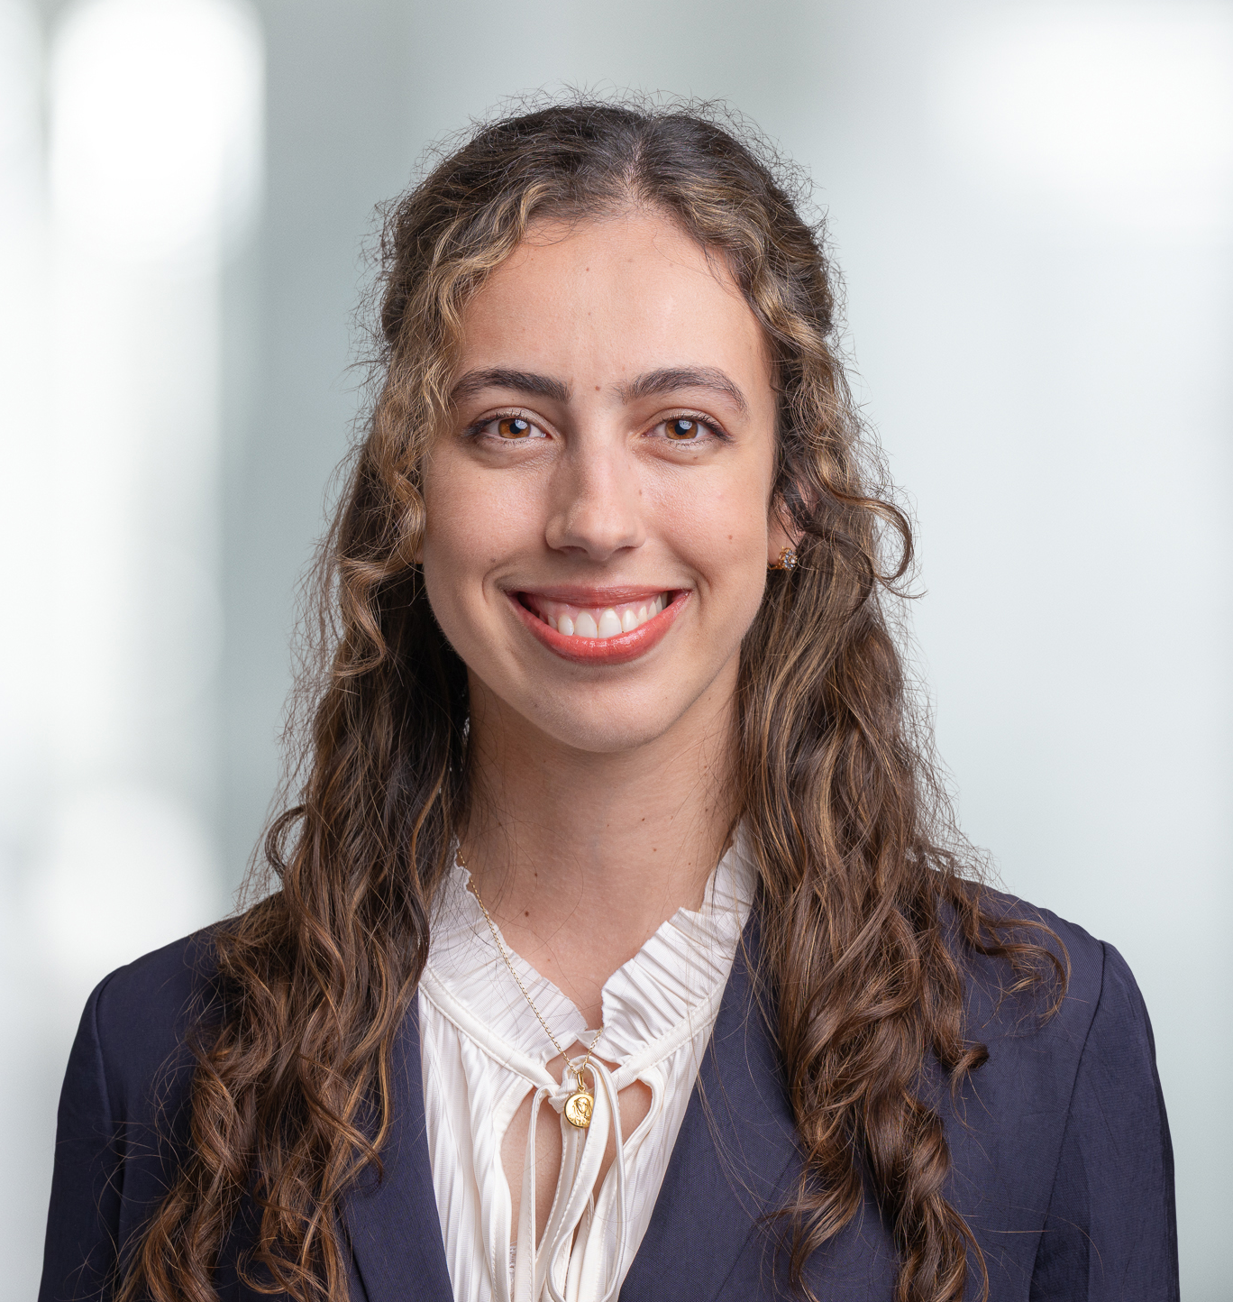
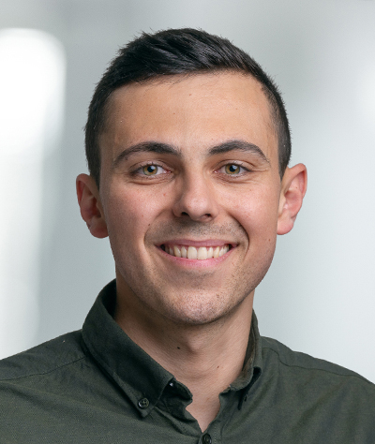
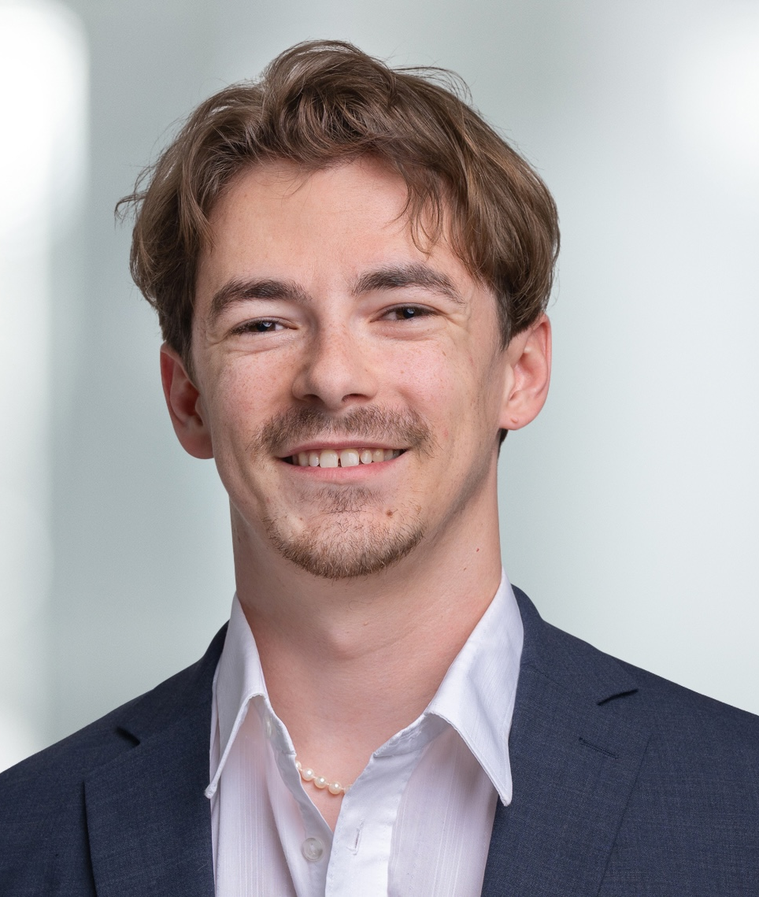
Presentation of the Chair
Dr. Mary Hausfeld
Dr. Florence Bernays
Dr. Ryan Miller
Lara Dolenc
Maria Diaz Macias
Leon Bach
Moritz Remund

Slide 8
The Scientific Process

Slide 9
What is scientific work?
The answering of a research question using theories or empirical data.
Report the results in a written manuscript, following strong rules and norms:
Formatting
Contribution
Literature review
Methods
Discussion
Limitations

Slide 10
Learning outcomes
Bachelor thesis (18 ECTS):
Understand the difference between various sources of information and knowledge (e.g., Wiki, newspaper, academic journals, textbooks)
Learn how to conduct an empirical study (but no necessity to collect primary data)
Learn how to work with the academic literature
Learn to write clearly in an academic style
Learn how to develop a contribution
Learn how to manage time, work autonomously, and integrate suggestions and feedback received

Slide 11
Learning outcomes
Master thesis (30 ECTS):
Learn how to collect and analyze primary data
Learn how to develop strong conceptual arguments and reflect on the limitations of the work
Learn to write an academic article
Learn how to relate the contribution to the existing literature
Learn how to engage in collaborative work with your advisor

Slide 12
Organization of the BA-/MA- Thesis

Slide 13
Organization of Thesis
Deadline to apply:
Thesis start:
Submission deadline:
15.10.2025. by end of day
Decisions sent by 31.10.2025 at the latest
Earliest 01.12.2025
Typically February 2026
https://www.oec.uzh.ch/en/studies/graduation/degree-deadlines.html

Slide 14
Organization of Thesis
Basic requirements:
Attend courses led by our Chair of Human Resources and Leadership
Bachelor: HRM and Organizational Behavior | Emotions and Moods | The Role of Technology in Shaping a People-Centric Future of Work
Master: Leadership Lecture | Leadership Research Seminar | The Emotionally Intelligent Organization | UZH Innovathon: Building a Human-Centered Future of Work | People Innovation Mindset: Building a Human-Centered Ecosystem
Every Semester: CEO Lecture Series: Leadership in the Future of Work
Participate in the Information Session
Write the thesis in English

Slide 15
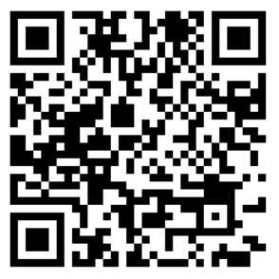

Slide 16
Organization of Thesis
Application documents:
Qualtrics Survey: https://uzhwwf.qualtrics.com/jfe/form/SV_cGSG0peIdKYAVLw
Transcript of University grades
CV
Cover letter (optional): Explain your motivation and the topics you would be interested in pursuing (it is recommended to have more than one; if so, rank order them clearly)
Please submit your application by the end of the day 15.10.2025

Slide 17
Organization of Thesis
We will review applications within 14 days after the deadline. Selected candidates will be assigned to one adviser.
Once “teams” are formed, selected candidates will contact their adviser to organize a meeting to discuss the general direction of their thesis.
Following this introductory meeting, the student will prepare and informally present an introductory report to settle the research question(s) and the general direction of the thesis:
If the report is approved, the candidate can proceed.
If the report is not accepted, the candidate has to modify/correct/improve the introductory report.

Slide 18
Introductory report
The introductory report will contain:
A preliminary title
An introduction to the topic and some potential hypotheses (about 3 pages long)
A basic organization of sections
A calendar with different goals and steps for the thesis
A reference list

Slide 19
Organization of Thesis
Once the short report has been approved, you will:
Register your thesis at the Dean’s office (performed through OLAT)
Have 6 months to write your thesis from the official start date
Meet your advisor at least once (after 2-3 months) but generally more frequently (about 7-8 times on average)
Submit your work when it is finished
Revise your thesis to incorporate any feedback received
Submit the final version of your thesis via OLAT & receive your grade (within 4 weeks after the final submission)

Slide 20
Evaluation of Thesis
We will evaluate the thesis on the following criteria:
Clear structure & quality of writing
Breadth and depth of the literature review
Quality of data collection and analysis (Master students; Bachelor students only if applicable)
Relevance and strength of novel ideas or contribution
Dedication to the project & quality of collaboration
Beware of plagiarism: Reference the origin of your work, including disclosing use of AI assistance

Slide 21
Presentation of supervised research ideas

Slide 22
Prof. Dr. Lauren Howe
TOPIC 1
How do employees use workspaces to regulate their emotions?
Project Start: January/February 2025 Profile: Bachelor/Master Method: Qualitative research study Availability: Team of max. 2
References: Bacevice & Spreitzer (2023); Petriglieri et al. (2018)
Notes:
Study where we've interviewed many employees from companies like ON, Vitra, and UZH about how workspaces make them feel and how they use workspaces to feel the emotions they want to feel at work. Research support would involve coding these interviews and potentially collecting new interview data (like for Masters theses where data is required)

Slide 23
Dr. Ryan Miller
TOPIC 1
Leaders’ self-disclosure of flaws: antecedents, processes, and outcomes
TOPIC 2
Leader experiences of guilt: Developing a taxonomy of the guilt leaders experience at & about work
Project Start: February 2025 Profile: Bachelor/Master Method: Qualitative coding, Interviews Availability: Alone or max. 2
Project Start: February 2025 Profile: Bachelor/Master Method: Qualitative - Interviews Availability: Alone or max. 2
References: Howe & Menges (2025), Jiang et al., (2002)
References: Tracy & Robins (2004), Schaumberg & Flynn (2012)

Slide 24
Maria Diaz Macias
TOPIC 1
Now or never: Perceptions of time and willingness to wait in the era of technology
TOPIC 2
Waiting Well: Temporal framing interventions to trigger (im-)patience
Project Start: February 2026
Profile: Bachelor/Master
Method: Quantitative or Qualitative
Availability: Alone or max. 2 students
Project Start: February 2026
Profile: Bachelor/Master
Method: Qualitative / Experimental
Availability: Alone or max. 2 students
References: Basiglio, Ricci, & Rossi (2025); Efrat‐Treister, Daniels, & Robinson (2020)
References: Schnitker & Westbrook (2014); Alan & Ertac (2018)

Slide 25
Moritz Remund
TOPIC 1
Emotional Consequences of AI: Can the preference for emotions influence the decision to use of AI?
TOPIC 2
The intelligence of the Gut: What role does Emotional Intelligence play in gut decisions?
TOPIC 3
Outsourcing Humanity: Does using AI for social connections reduce our Emotional Intelligence?
Project Start: Feb 2026
Profile: Bachelor/Master
Method: Quantitative Research
Availability: Alone or max. 2
Project Start: Feb 2026
Profile: Bachelor/Master
Method: Quantitative Experiment
Availability: Alone or max. 2
Project Start: Feb 2026
Profile: Bachelor/Master
Method: Quantitative Experiment
Availability: Alone or max. 2
References: Webb, DelDonno, & Killgore (2014)
References: Shanmugasundaram & Tamilarasu (2023)
References: Remund & Bernays (2025)

Slide 26



Lara Dolenc
TOPIC 1
Should I flaw or not to be more charismatic? : Experimental investigation of flaw type, gender and charismatic outcomes in leaders.
Project Start: February 2026
Profile: Bachelor/Master (Video creation & Editing skills/ interest a plus)
Method: Experimental Research Study (Video Experiment – experiment set up, data collection and analysis)
Availability: 1 student
References: Antonakis et al. (2016); Howe & Menges (2025)

Slide 27
Leon Bach
TOPIC 1
Emotion Beliefs: What do leaders think about the role of negative emotions at work?
TOPIC 2
Happiness and Performance Booster: Can Employees learn emotional microskills to feel and do better?
TOPIC 3
A hero journey at work: Can a hero journey narrative improve work meaningfulness?
Project Start: Dec 2025/Feb 2026
Profile: Bachelor/Master
Method: Interviews
Availability: Alone or max. 2
Project Start: Dec 2025/Feb 2026
Profile: Bachelor/Master
Method: Field Experiment
Availability: 3 students
Project Start: Dec 2025/Feb 2026
Profile: Bachelor/Master
Method: Field Experiment
Availability: 3 students
References: Ford & Gross (2019)
References: Locklear et al. (2021)
References: Rogers et al. (2023)

Slide 28
Contact
You will find all relevant information on our website:
https://www.business.uzh.ch/en/research/professorships/hrmlead.html
You may submit your application via the following Qualtrics survey:
https://uzhwwf.qualtrics.com/jfe/form/SV_cGSG0peIdKYAVLw
For any additional questions, please do not hesitate to contact me:
mary.hausfeld@business.uzh.ch

Slide 29
Questions
Do you have any remaining questions?

Slide 31
Thank you!
Chair of HRM and Leadership
Center for Leadership in the Future of Work University of Zurich
Plattenstrasse 14 8032 Zurich
www.leadthefuture.org

