Slide 1

Globalisierung und Multinationale Unternehmen
Teil I: Die Globalisierung als Herausforderung für Weltwirtschaft, multinationale Unternehmen und verantwortliches Handeln
Vorlesung 1: Grundbegriffe und Problemtatbestände
ERGÄNZUNGEN
Universität Zürich, FS 2025; 17./19. Februar 2025
Prof. Dr. Andreas Georg Scherer

Slide 2
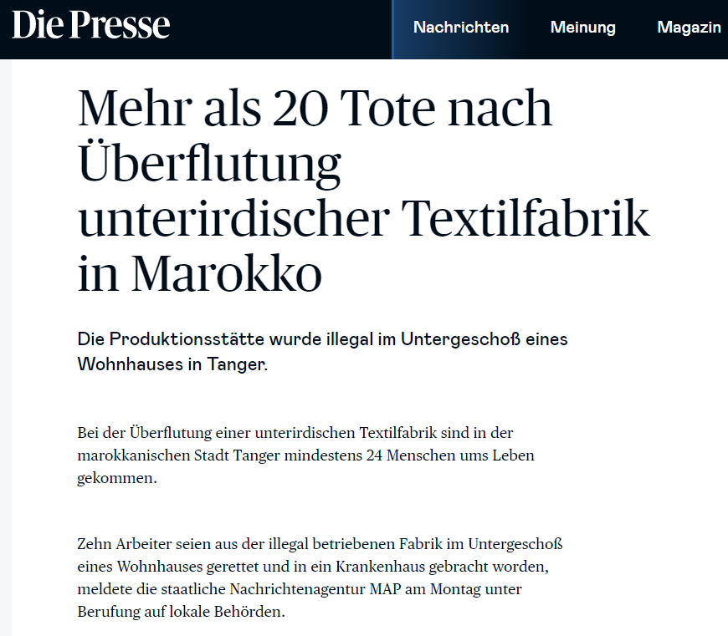
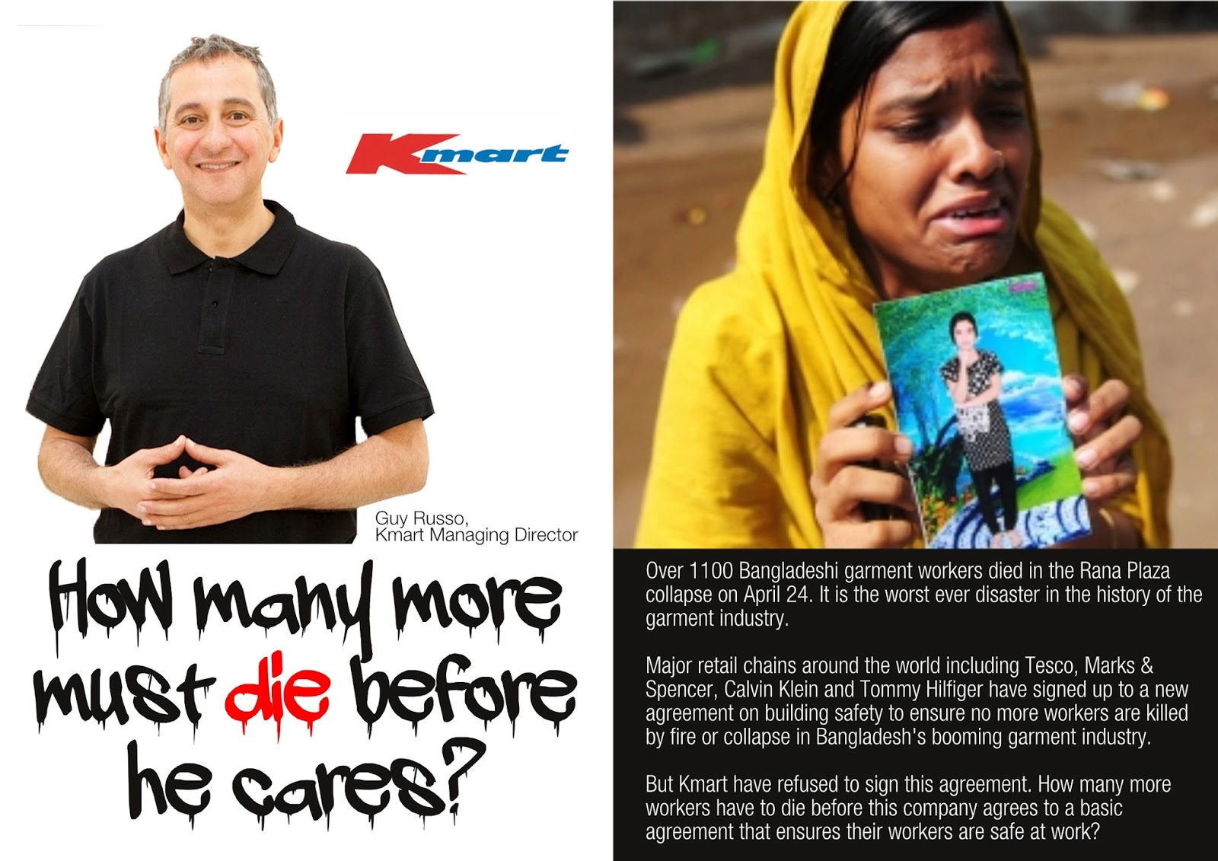

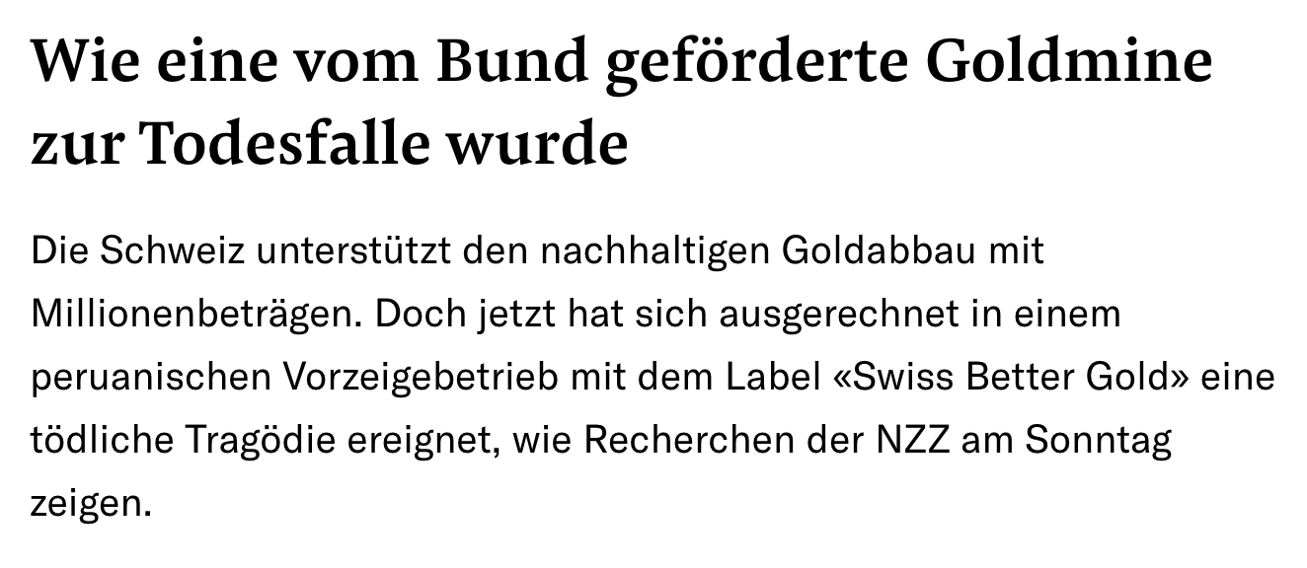
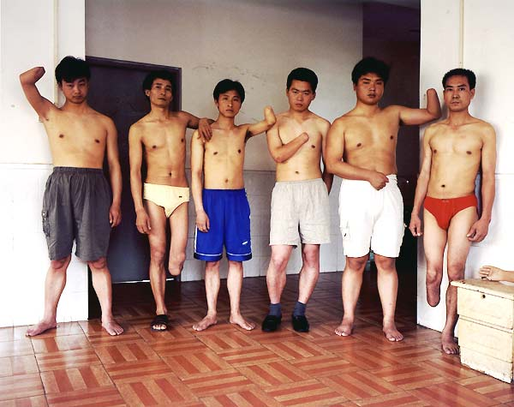


19.05.2013
Wer ist verantwortlich? Einhaltung von Menschen-rechten: Arbeitssicherheit in Zulieferbetrieben
A Arbeiter selbst
B Importeur in der Schweiz
C Zulieferer aus Asien
D Staat in Asien
According to the ILO more than
2.9 million work-related deaths occur annually on a global scale, and there are about 395 million non-fatal work-related injuries each year. Especially developing countries are affected.
08.02.2021
Every 15 seconds,
1.5 worker dies from a work-related accident
or disease.
188 workers have a work-related accident.
Foto: Verunfallte Arbeiter in asiatischen Zulieferbetrieben
Quelle: ILO, https://www.ilo.org/wcmsp5/groups/public/---ed_protect/---protrav/---safework/documents/publication/wcms_903140.pdf (Abruf: Jan 2024)
Notes:
https://www.nzz.ch/nzz-am-sonntag/wie-eine-vom-bund-gefoerderte-goldmine-zur-todesfalle-wurde-ld.1738919?reduced=true

Slide 3
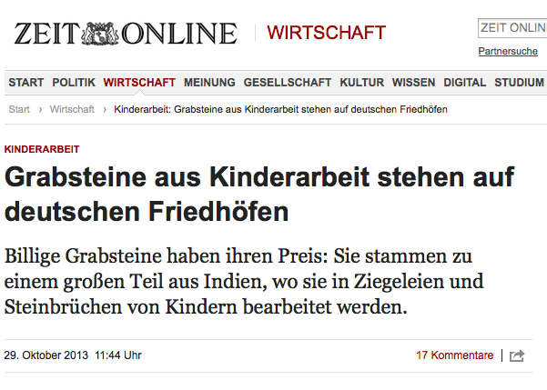

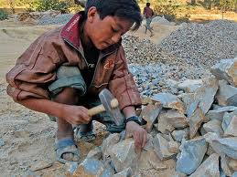
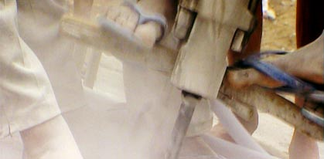
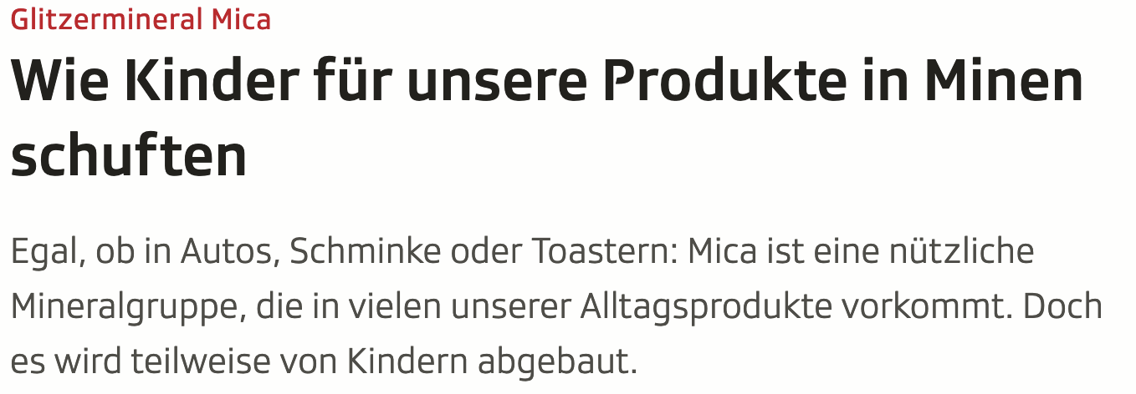
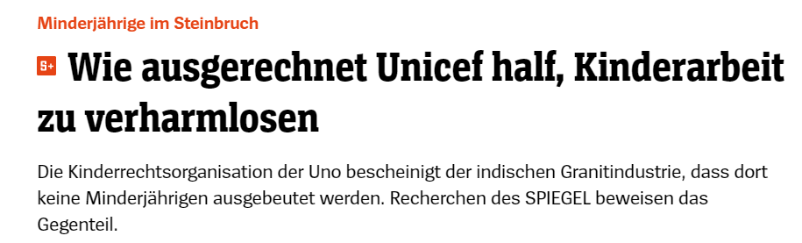
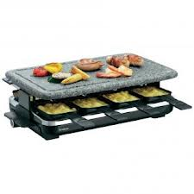
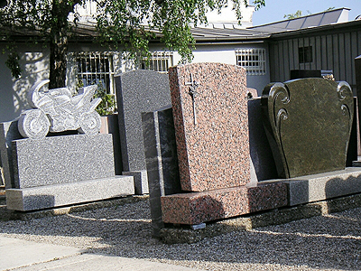
Wer ist verantwortlich? Einhaltung von Menschenrechten: Kinderarbeit in Steinbrüchen
31.01.2020
The ILO’s most recent global estimate is that 160 million children worldwide are victims of child labour, with almost half of them (79 million) involved in hazardous work (endangering health, safety and moral development) and other worst forms of child labour — such as prostitution, mining and slave labour in different industries.
25.05.2023
Quelle: https://www.ilo.org/ipec/ChildlabourstatisticsSIMPOC/WCMS_817699/lang--en/index.htm (Abruf: Jan 2024)

Slide 4
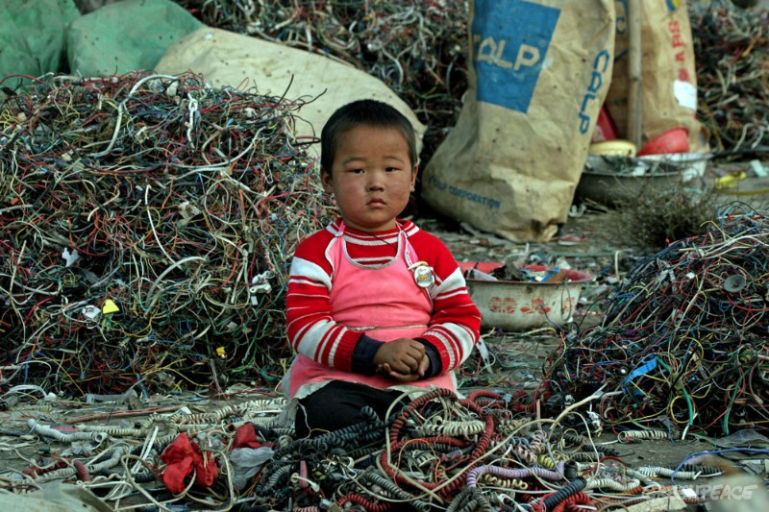
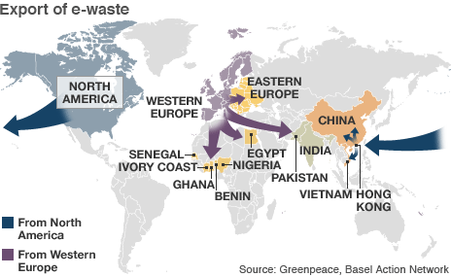
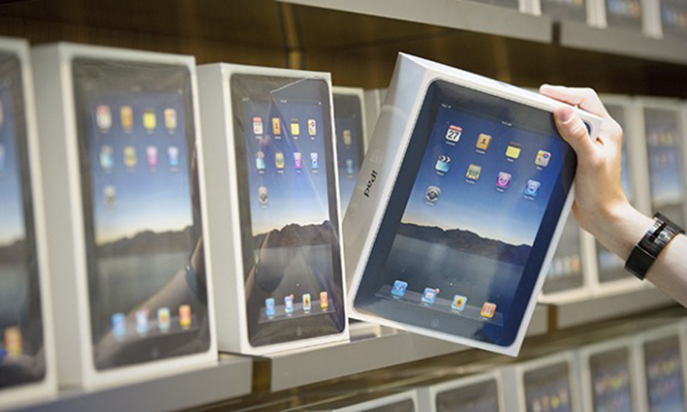
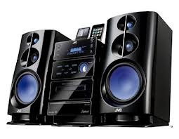
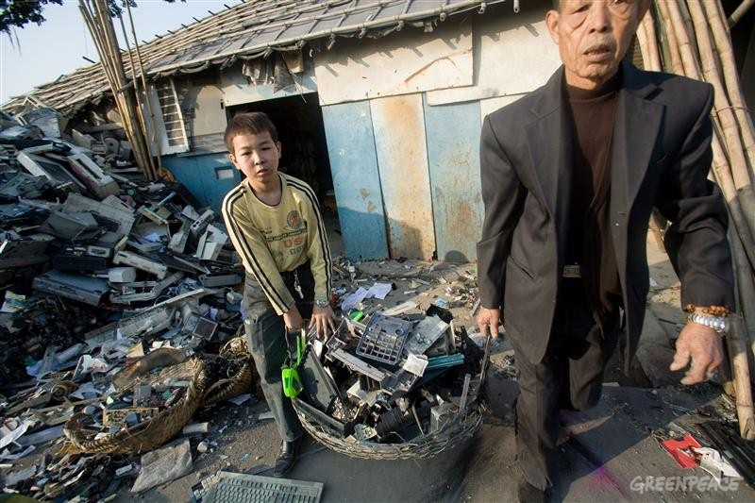
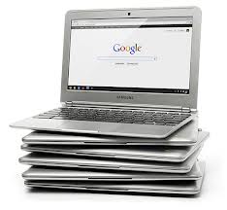
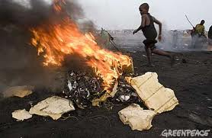
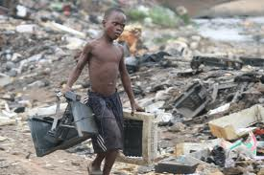
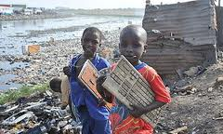
Wer ist verantwortlich? Einhaltung von Umweltstandards: E-trash dumping in Afrika
According to the UN global production of e-waste now totals at 53.6 million metric tonnes (about 7.3 kg for every person on the planet), of which only 17.4% is recycled. Hazardous substances are released when e-waste is stripped down, often on vast unofficial waste dumps where workers lack protective clothing and health and safety regulations are poor or non-existent (numbers as of 2020).
Quellen:
The Global E-waste Monitor 2020, https://www.itu.int/en/ITU-D/Environment/Documents/Toolbox/GEM_2020_EN_O21.pdf;
http://www.guardian.co.uk/environment/2011/may/16/uk-ewaste-dumped-ghana (Abruf: Jan 2013)

Slide 5
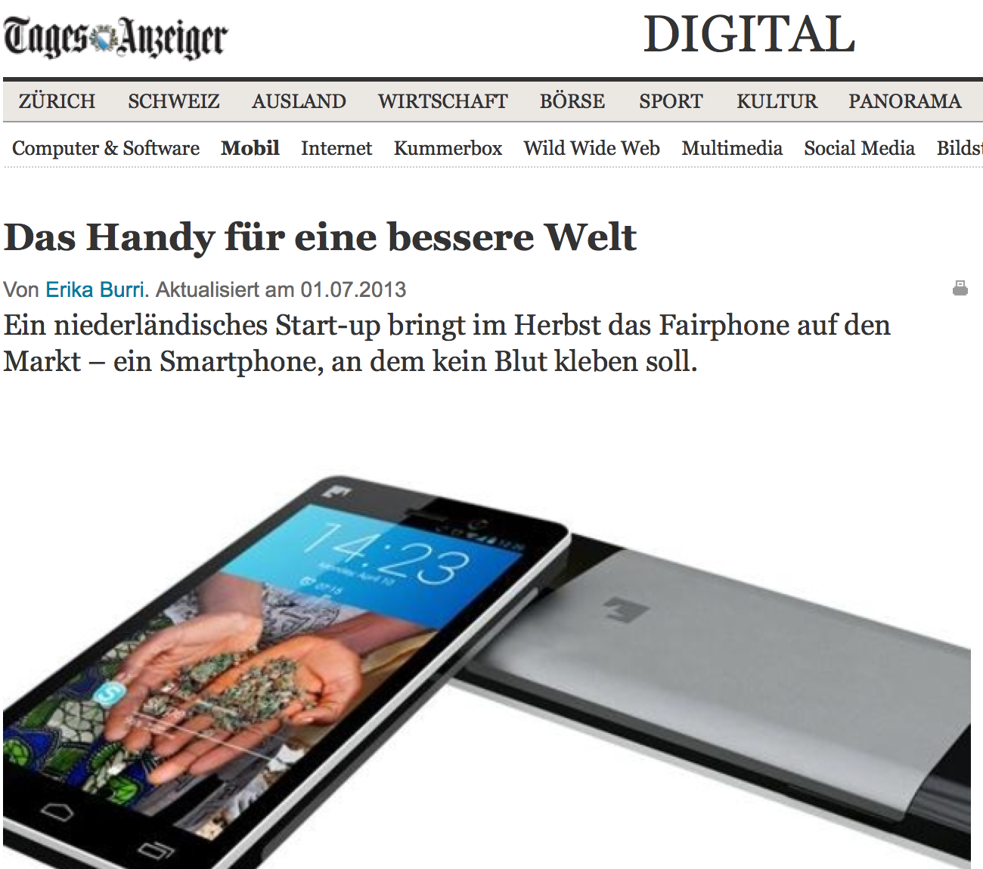


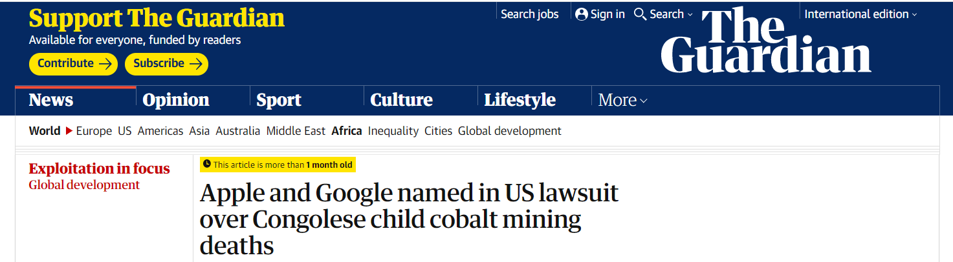


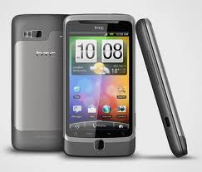
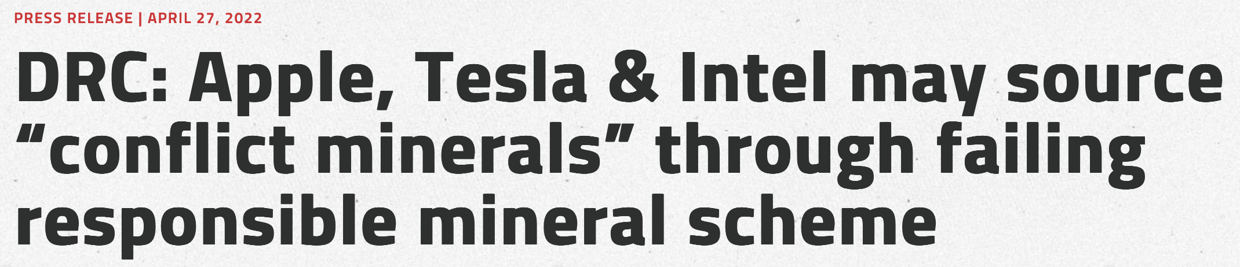
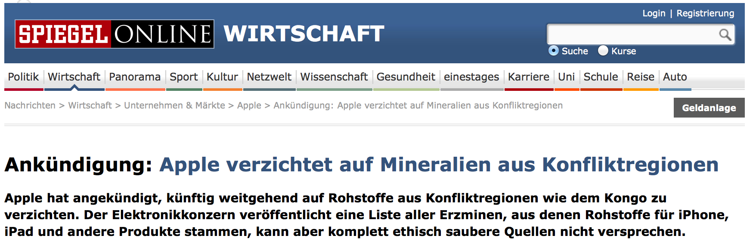
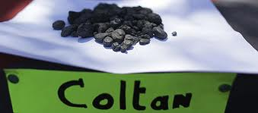
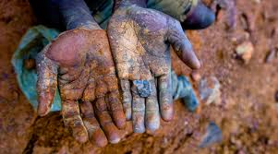
Wer ist verantwortlich? Blut im Handy:
Mobiltelefone und “the world’s deadliest war“
http://www.youtube.com/watch?feature=player_embedded&v=wQhlLuBwOtE
16.12.2019
13.02.2014
New York Times (2012):
http://bits.blogs.nytimes.com/2012/02/13/apple-announces-independent-factory-inspections/
Notes:
https://www.globalwitness.org/en/press-releases/drc-apple-tesla-intel-may-source-conflict-minerals-through-failing-responsible-mineral-scheme/

